Slide 1




BLOCKCHAIN
Kaihua Qin, Stefanos Chaliasos, Liyi Zhou, Benjamin Livshits, Dawn Song, Arthur Gervais

Slide 2
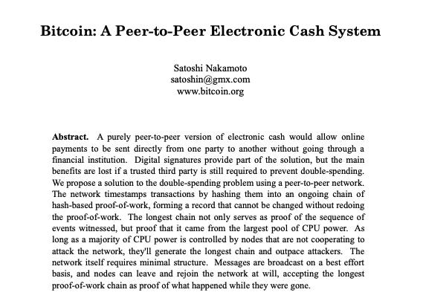
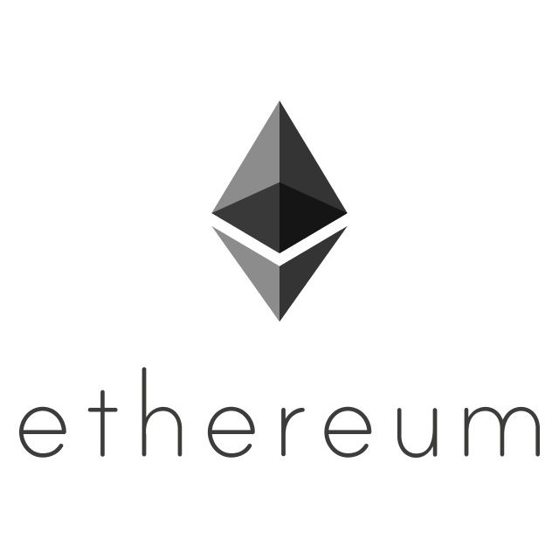
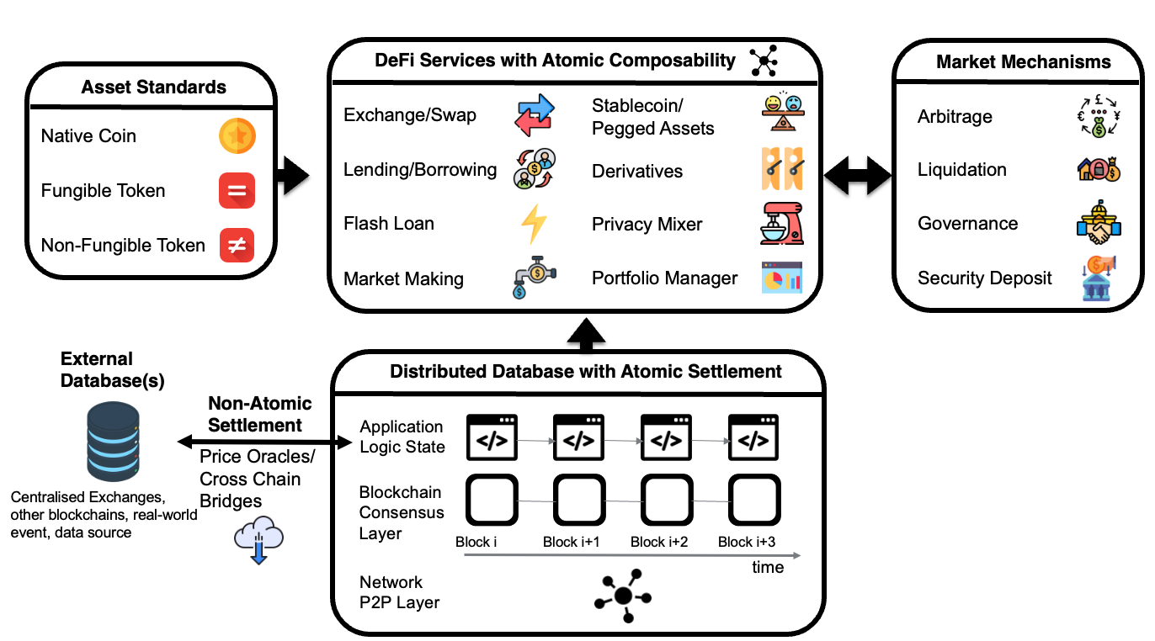
Decentralized Finance
2008
2014
2020

Slide 3




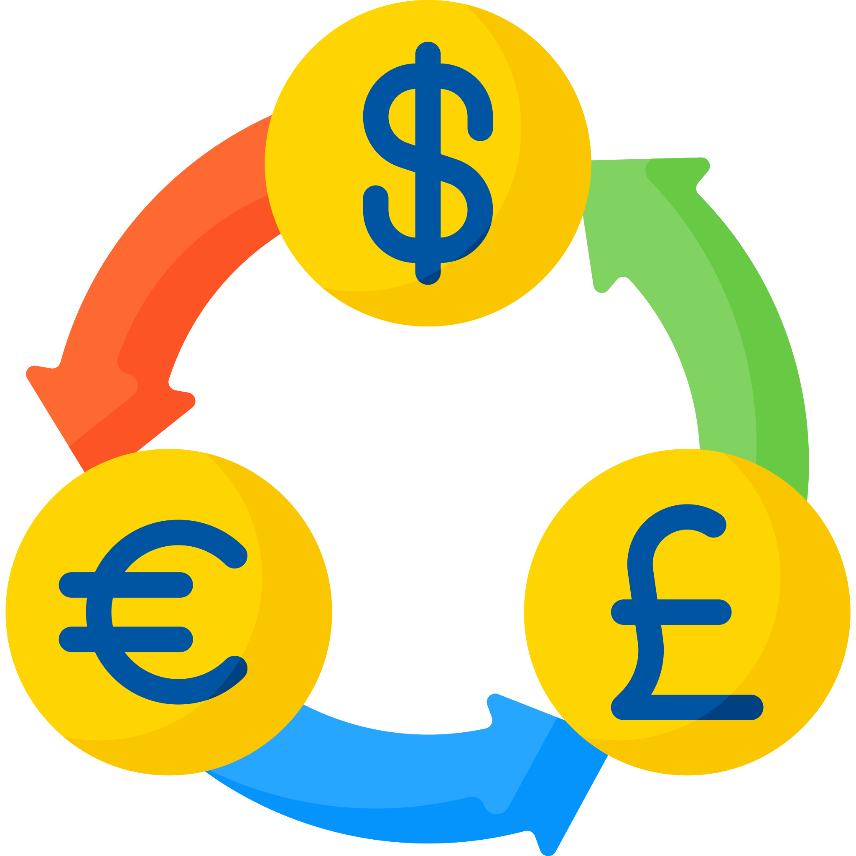


MEV Extraction
MEV Searcher
MEV Transaction
Arbitrage
Liquidation
contract MEV {
function arb(uint x, uint y) public {
swapETHtoUSDC(x);
swapUSDCtoETH(y);
msg.sender.transfer(profit);
}
}
DeFi Attack

Slide 4

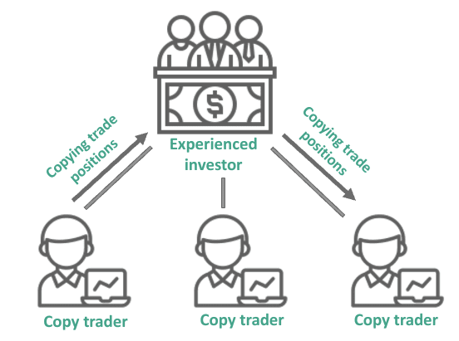
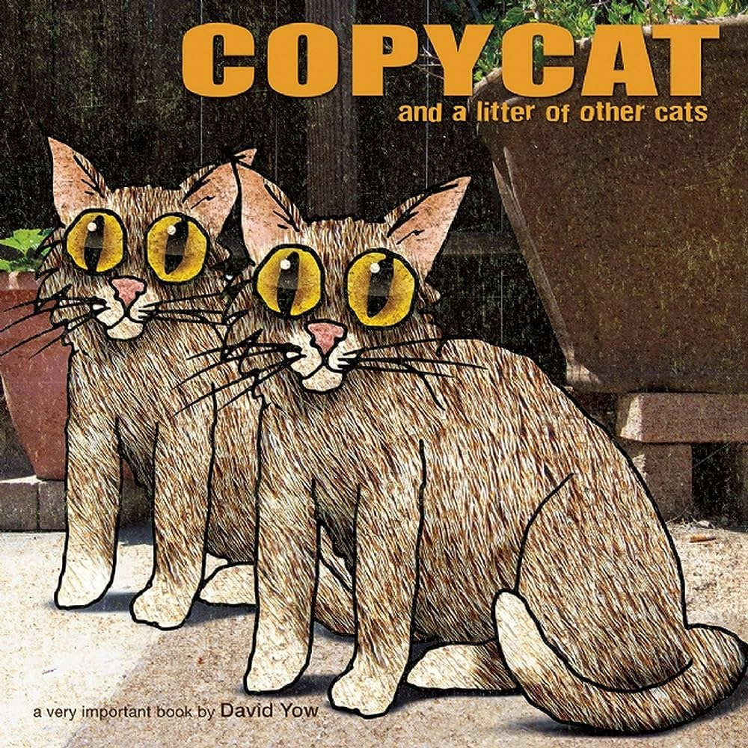
The Blockchain Imitation Game

Slide 5
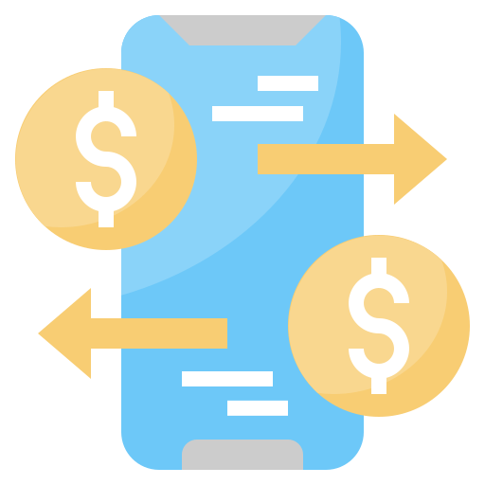





Imitation
Creation
Observation
Execution
Copy-paste
Front-run

Slide 6
Naive Imitation
Blind duplicate & string replacement
Verify locally & front-run
Simple but effective
35M USD (December 2018 – August 2021) on Ethereum
Easy to prevent
contract MEV {
function arb(uint x, uint y) public {
swapETHtoUSDC(x);
swapUSDCtoETH(y);
msg.sender.transfer(profit);
}
}
require(msg.sender==0x12..);
Qin K, Zhou L, Gervais A. Quantifying blockchain extractable value: How dark is the forest?. In 2022 IEEE Symposium on Security and Privacy (SP) 2022 May 22 (pp. 198-214). IEEE.

Slide 7



Slide 8
Ape — Generalized Imitation
Imitate
&
Synthesize
contract MEV {
function arb(uint x, uint y) public {
require(msg.sender==0x12..);
swapETHtoUSDC(x);
swapUSDCtoETH(y);
msg.sender.transfer(profit);
}
}
contract MEV {
function arb(uint x, uint y) public {
require(msg.sender==0x12..);
swapETHtoUSDC(x);
swapUSDCtoETH(y);
msg.sender.transfer(profit);
}
}
Qin K, Chaliasos S, Zhou L, Livshits B, Song D, Gervais A. The blockchain imitation game. (2023). In 32nd USENIX Security Symposium (USENIX Security 23) (pp. 3961-3978).

Slide 9





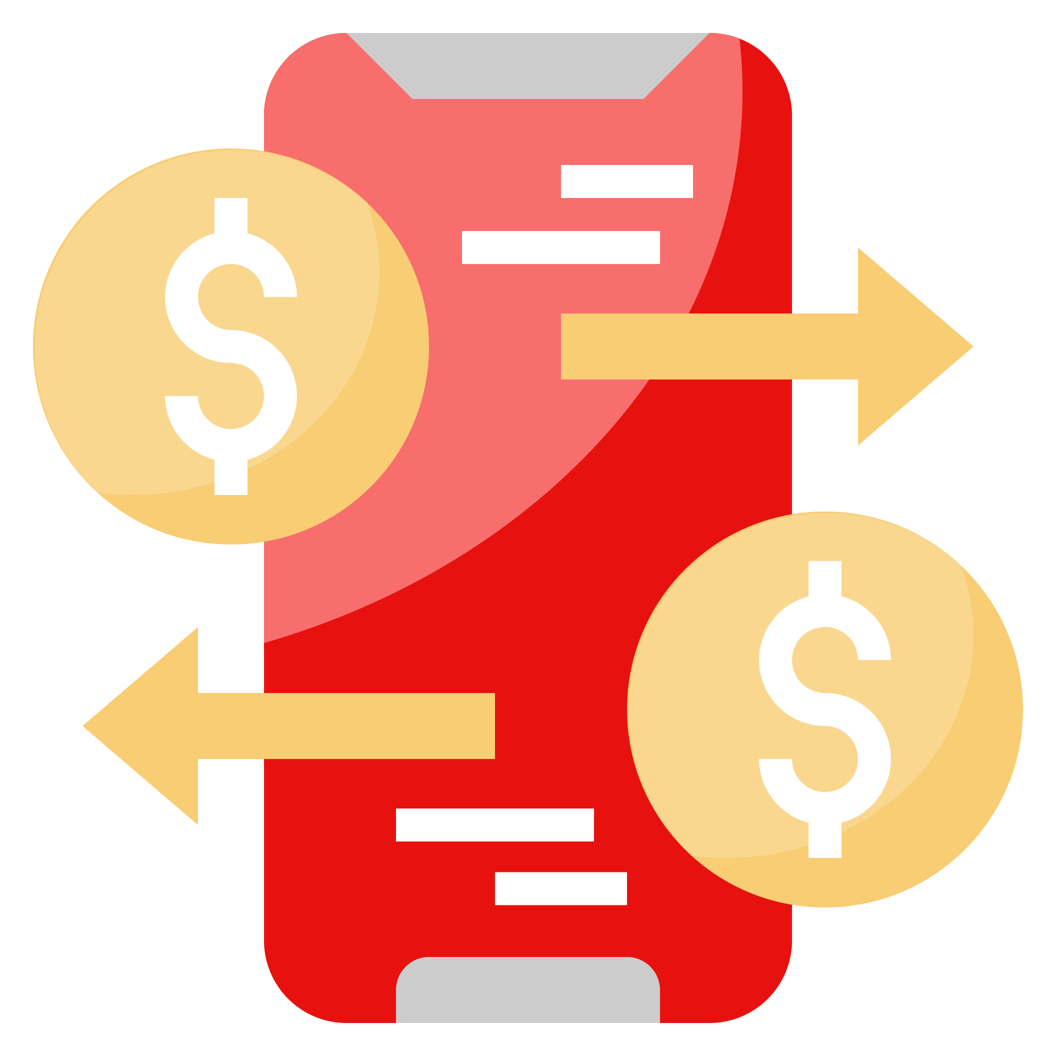



Ape Overview
Ape
Step 1
Step 2
Step 3
Pending transaction
Dynamic control-flow graph
Profitability analyzer
Dynamic taint analysis
Imitation transaction
Smart contract synthesis
Validation
Patch identifier
Step 6
Step 5
Step 4

Slide 10
Dynamic Taint Analysis
Why does a naive imitation fail?
difference (e.g., transaction sender) → conditional jump → different execution path
JUMPDEST
CALLER
PUSH20 0x12..
EQ
PUSH2 0xb2c
JUMPI
PUSH1 0x0
DUP1
REVERT
contract MEV {
function arb(uint x, uint y) public {
swapETHtoUSDC(x);
swapUSDCtoETH(y);
msg.sender.transfer(profit);
}
}
require(msg.sender==0x12..);

Slide 11
Patch Identifier
Ensure synthesized contract(s) are probably invoked
contract A {
address MEV = 0x34..;
function e() public {
x = 10;
y = 50;
MEV.arb(x, y);
}
}
contract MEV {
function arb(uint x, uint y) public {
swapETHtoUSDC(x);
swapUSDCtoETH(y);
tx.origin.transfer(profit);
}
}
require(tx.origin==0x12..);
A’
MEV’

Slide 12
Contract Synthesis
Copy executed bytecode with amendments
JUMPDEST
CALLER
PUSH20 0x12..
EQ
PUSH2 0xb2c
JUMPI
PUSH1 0x0
DUP1
REVERT
JUMPDEST
CALLER
PUSH20 0x12..
EQ
PUSH2 0xb2c
- JUMPI
+ SWAP1
+ POP
+ JUMP
PUSH1 0x0
DUP1
REVERT
JUMPI Forcing
Invocation Redirection
Storage Recovery
Asset Transfer Redirection

Slide 13




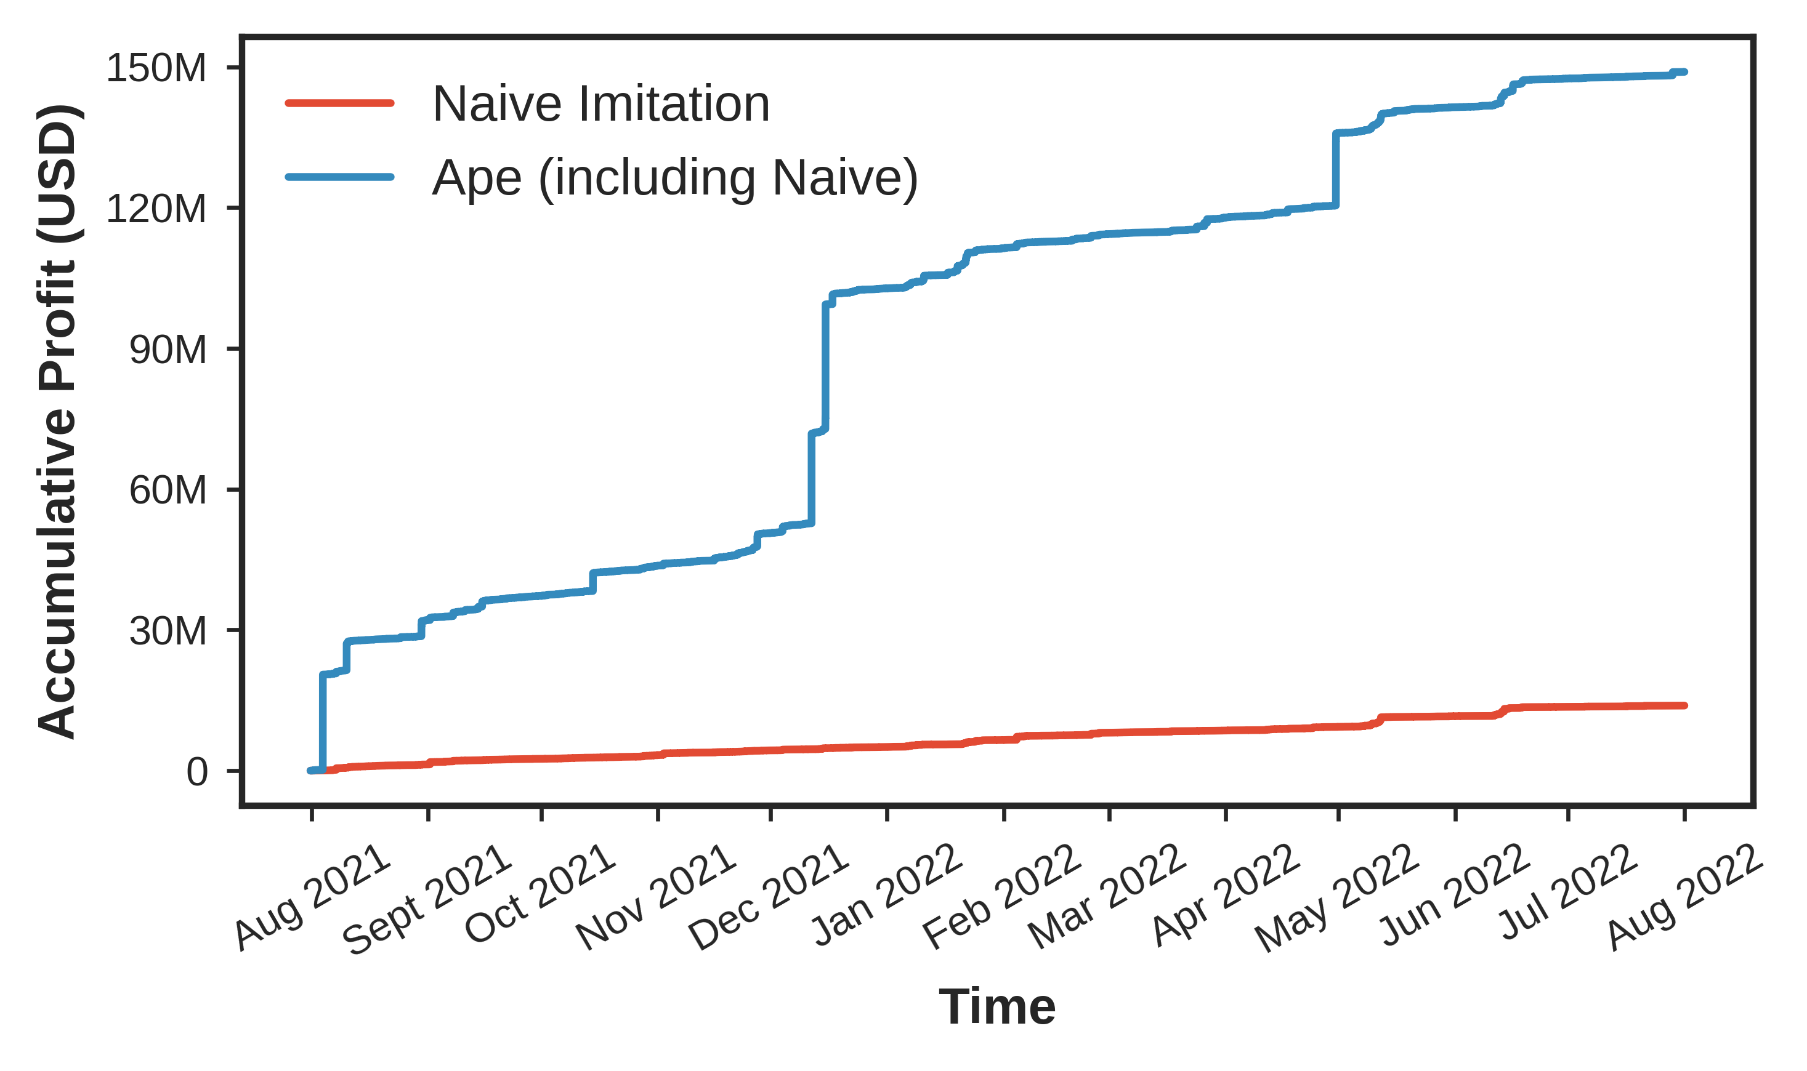
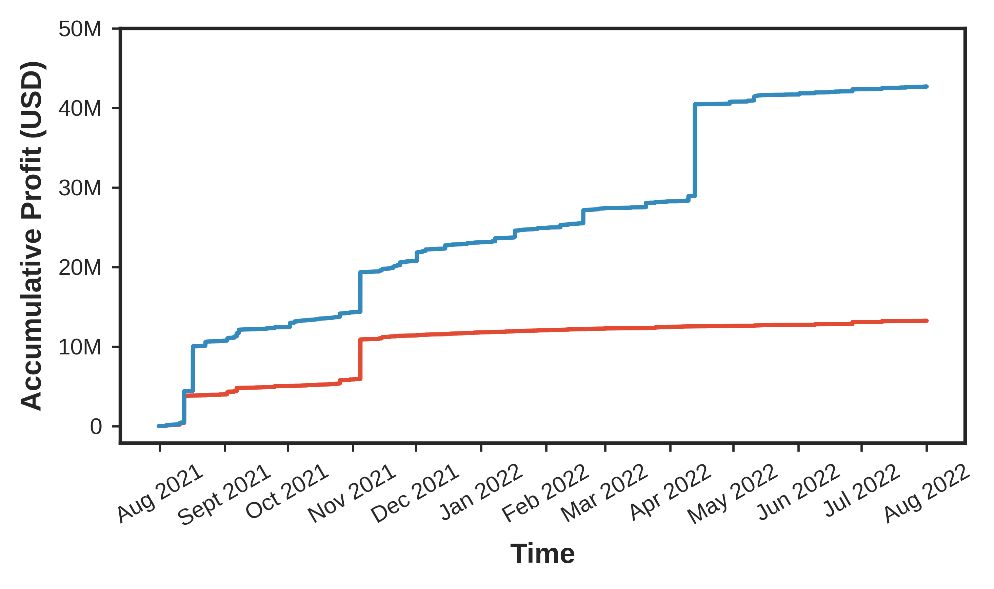
Ape Evaluation
August 1, 2021 – July 31, 2022 (1 year)
0.07 second
Ethereum
148.96M USD
BSC
42.70M USD

Slide 14


Imitation as Whitehat
DeFi Attacks
Ethereum
BSC
29
73.74M USD
40
22.39M USD
Protocol | Loss (USD) | Date
Popsicle Finance | 20.25M | Aug-03-2021
Saddle Finance | 9.71M | Apr-30-2022
Indexed Finance | 3.58M | Oct-14-2021
… | … | …
Protocol | Loss (USD) | Date
Elephant Money | 11.52M | Apr-12-2022
XSURGE | 5.17M | Aug-16-2021
CollectCoin | 1.06M | Dec-01-2021
… | … | …

Slide 15

Questions
Kaihua Qin

